Slide 1
Greatness in the Kingdom
Kingdom Character
(Matt 5:1-12)
Kingdom
Calling
(Matt 5:13-16)
Kingdom Conduct
(Matt 5:17-7:27)

Slide 2
Greatness in the Kingdom
… you have heard it was said…
… but I say
to you …
… unless your righteousness exceeds that of the Scribes and Pharisees …
(Matt. 5:20)

Slide 3
Matthew 5:43-48
⁴³ "You have heard that it was said, 'You shall love your neighbour and hate your enemy.' ⁴⁴ But I say to you, Love your enemies and pray for those who persecute you, ⁴⁵ so that you may be sons of your Father who is in heaven. For he makes his sun rise on the evil and on the good, and sends rain on the just and on the unjust.

Slide 4
Matthew 5:43-48
⁴⁶ For if you love those who love you, what reward do you have? Do not even the tax collectors do the same? ⁴⁷ And if you greet only your brothers, what more are you doing than others? Do not even the Gentiles do the same? ⁴⁸ You therefore must be perfect, as your heavenly Father is perfect.

Slide 5
Greatness in the Kingdom!
Love your neighbour
and hate your enemy
You have heard that it was said …
(Matt 5:43)

Slide 6
Greatness in the Kingdom!
Love your neighbour
and hate your enemy
You have heard that it was said …
(Matt 5:43)

Slide 7
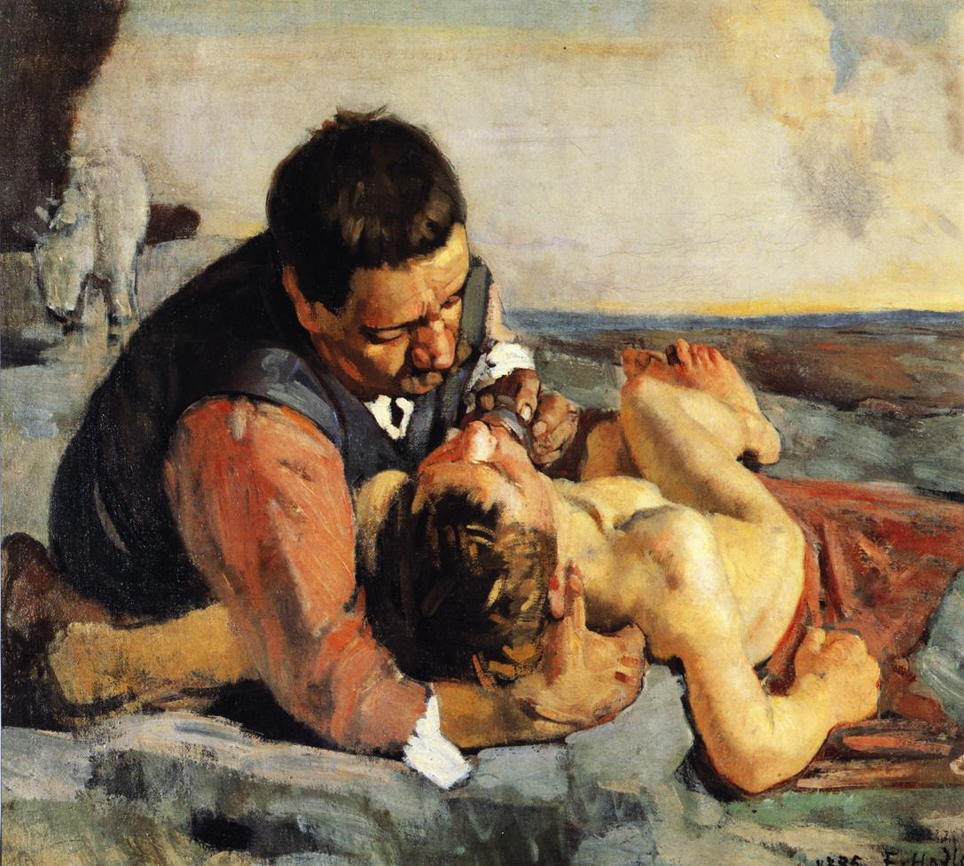
Greatness in the Kingdom!
… love your neighbour as yourself.
(Luke 10:27)
… and who is my neighbour?
(Luke 10:29)
… the despised Samaritan!
(Luke 10:33)
The Parable of the Good Samaritan

Slide 8
Greatness in the Kingdom!
… but I say to you …
(Matthew 5:44)

Slide 9
Greatness in the Kingdom!
… and who is
my enemy?
hostile
ill treat
falsely accuse
spiteful
abusive
take advantage
… but I say to you, love your enemies …
(Matthew 5:44)

Slide 10
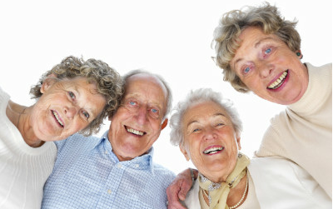
Greatness in the Kingdom!
storge
philia
storge
filia
eros
agape
eroß
agape
… but I say to you, love your enemies …
(Matthew 5:44)

Slide 11
Greatness in the Kingdom!
Loving enemies (Luke 6)
do good (6:27,35)
bless (6:28)
pray (6:28)
turn cheek (6:29)
offer cloak (6:29)
be generous (6:30,35)
second mile (Matt 5:41)
Ask yourself what you want people to do for you; then grab the initiative and do it for them! (Luke 6:31)
… but I say to you, love your enemies …
(Matthew 5:44)

Slide 12
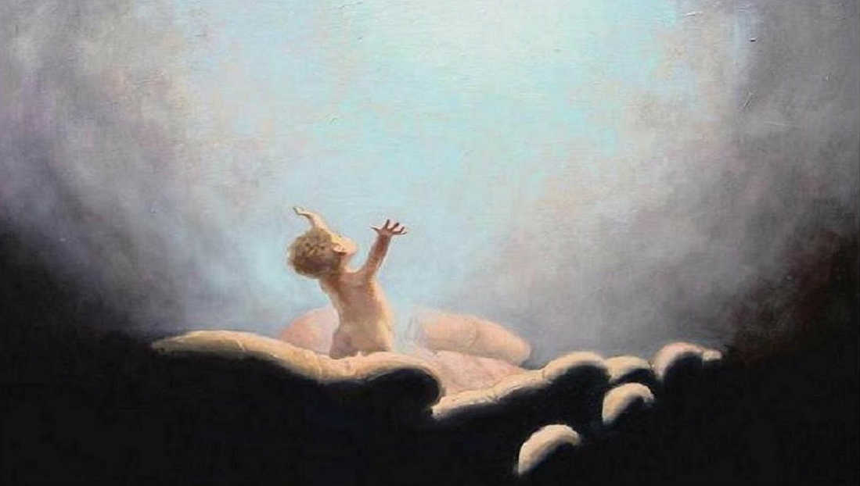
Greatness in the Kingdom!
“heavenly Father-like”
… so that you may be sons of your Father …
(Matthew 5:45)

Slide 13
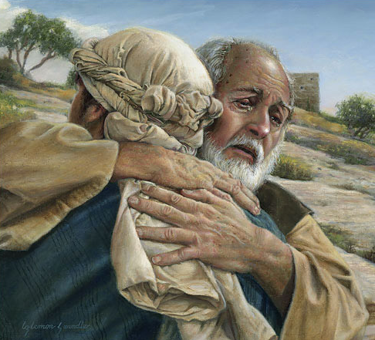
Greatness in the Kingdom!
heavenly Father-like
♥ Unprejudiced (5:45)
♥ Unselfish (5:45)
♥ Unlimited (5:47)
♥ Unconditional (5:46)
… so that you may be sons of your Father …
(Matthew 5:45)

Slide 14
Greatness in the Kingdom!
Be perfect as
your heavenly
Father is perfect
(Matt 5:48)

